Slide 1

LIVE SEARCH WEATHER APP
Mini Project II Presentation
GLA University
Department of CEA
Presented By:
Ashish Agarwal(181500137)
Mohan Agrawal(181500385) Submitted To: Mr. Akash Kumar Choudhary

Slide 2
Introduction
In our work, we develop the React Weather app which can provide accurate forecasts to enable users to make informed decisions.
In the project we are using React Functional Component, React Hooks, React Fetch API, and many more concepts in our live search weather app using React JS.
The focus of this project is to know about the weather conditions by entering the city, where the user wants to know about the weather.

Slide 3
Problem Statement
Today, weather apps can provide accurate forecasts to enable users to make informed decisions.
Since ages, humans want to know about weather conditions in advance and weather apps make it possible to predict weather conditions on the move.

Slide 4
Objective
The primary object of this Live Search Weather App is to provide the current temperature in the city in degree Celsius if the entered city name exists.
And if the entered city name does not exists, it shows No Data Found.
To get the minimum and maximum temperature in the city.

Slide 5
System Requirements
1. Hardware Requirements:
Processor: i3 or above
RAM: 4 GB or above
Disc space: 20 GB (3 GB for database files + enough GB for shared documents, individual)
Network card required
2. Software Requirements:
Git package
Visual Studio Code as IDE
Operating System : Windows 7

Slide 6
Languages Used
HTML
CSS
JavaScript
React JS

Slide 7
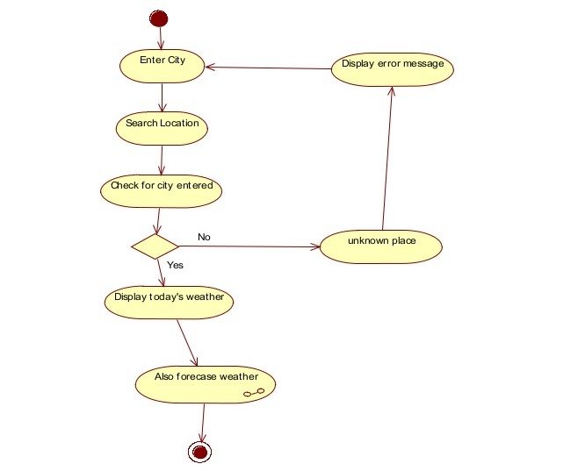
Software Design
Activity Diagram:

Slide 8
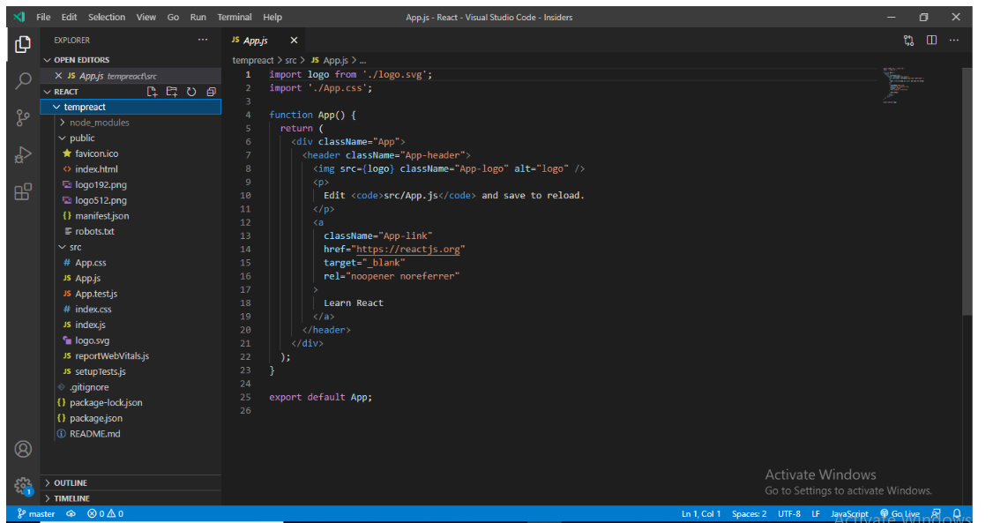
Implementation
1. React Folder:

Slide 9
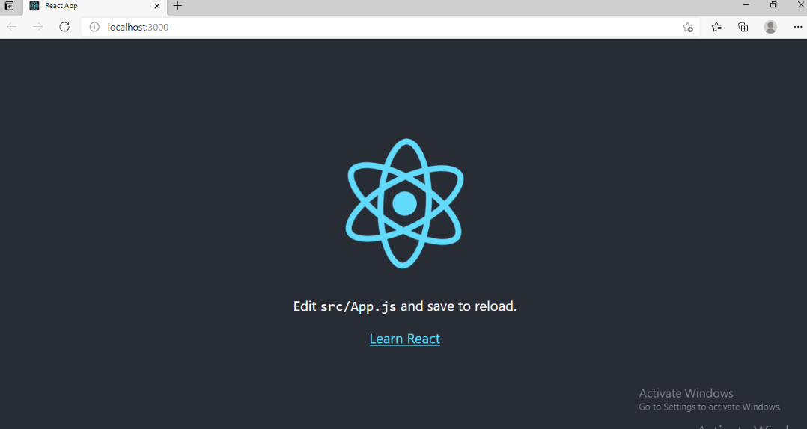
Implementation
2. Successful Installation of React App:

Slide 10
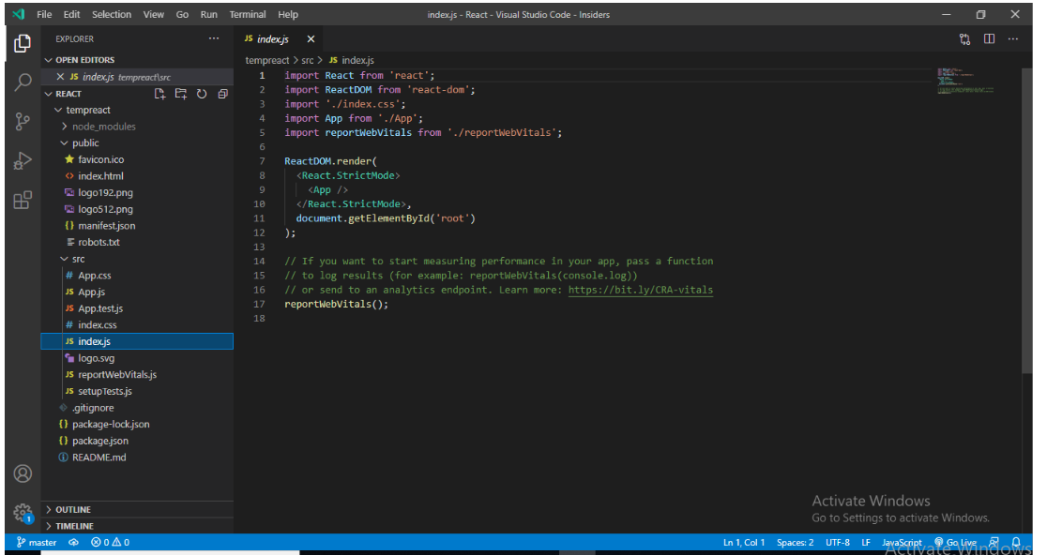
Implementation

Slide 11
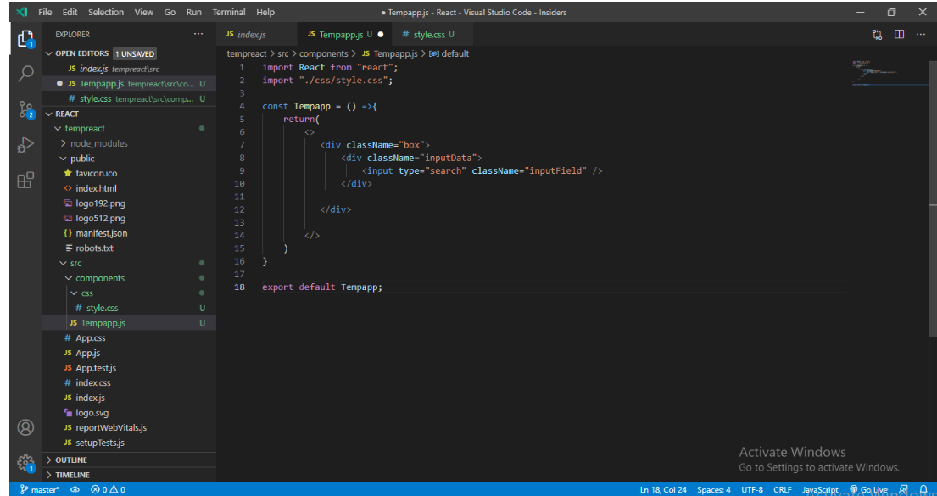
Implementation

Slide 12
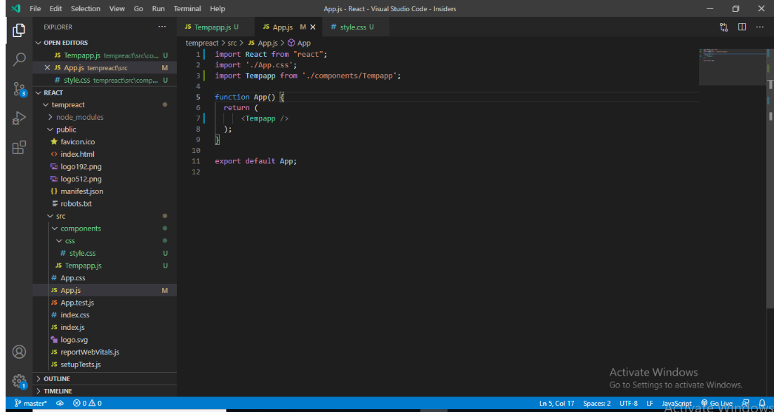
Implementation

Slide 13
Conclusion
We learned a lot through this project. This project has sharpened our concept of React JS like use of React Functional Component, React Hooks, React Fetch API, and many more concepts.
After the completion of project, user can search the weather conditions of different cities which they want to search.

Slide 14
THANK YOU

